Slide 1
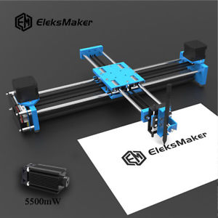
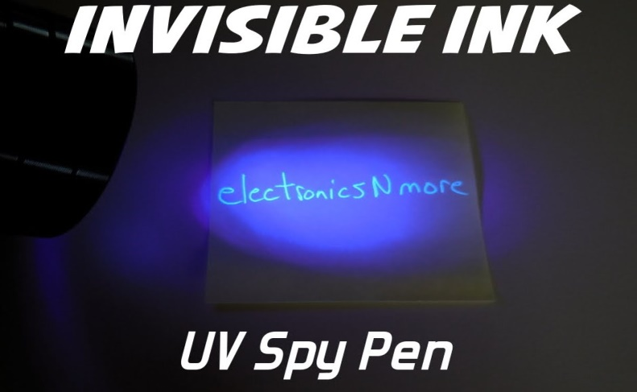
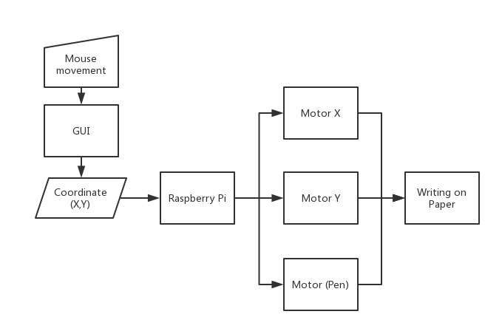
Realtime 2D Printer
Wei Zhang
Honghao Wang
Huanyu Zhang
Print out invisible message in the case of emergency
Offer assist in the creation of complex UV paintings
In the future applications the printer can achieve more purposes by replacing UV pen with other tools

